Slide 1
Agile methodology

Slide 2
The Agile Model is an incremental and iterative process of software development. It defines each iteration’s number, duration, and scope in advance. Every iteration is considered a short “frame” in the Agile process model, which mostly lasts from two to four weeks.
Agile Model divides tasks into time boxes to provide specific functionality for the release. Each build is incremental in terms of functionality, with the final build containing all the attributes. The division of the entire project into small parts helps minimize the project risk and the overall project delivery time.

Slide 3
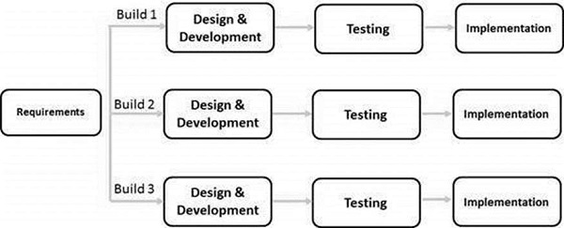
Iterative phases:
Phase 1: login module
Phase 2: Admin panel and Student panel

Slide 4
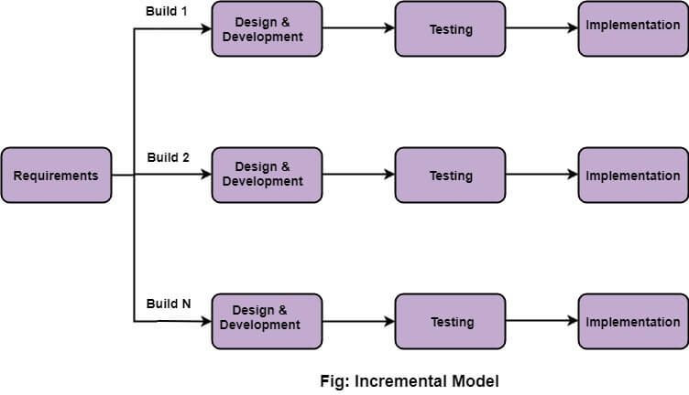
Incremental: Phase 1: Basic features Phase2: intermediate. Phase 3: Advanced features
Incremental approach

Slide 5
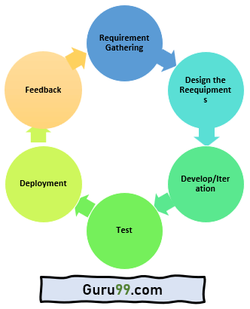

Slide 6
Here are the important stages involved in the Agile Model process in the SDLC life cycle:
Requirements Gathering: In this Agile model phase, you must define the requirements. The business opportunities and the time and effort required for the project should also be discussed. By analyzing this information, you can determine a system’s economic and technical feasibility.
Design the Requirements: Following the feasibility study, you can work with stakeholders to define requirements. Using the UFD diagram or high-level UML diagram, you can determine how the new system will be incorporated into your existing software system.
Develop/Iteration: The real work begins at this stage after the software development team defines and designs the requirements. Product, design, and development teams start working, and the product will undergo different stages of improvement using simple and minimal functionality.
Test: This phase of the Agile Model involves the testing team. For example, the Quality Assurance team checks the system’s performance and reports bugs during this phase.
Deployment: In this phase, the initial product is released to the user.
Feedback: After releasing the product, the last step of the Agile Model is feedback. In this phase, the team receives feedback about the product and works on correcting bugs based on the received feedback.
Compared to Waterfall, Agile cycles are short. There may be many such cycles in a project. The phases are repeated until the product is delivered.

Slide 7
types of agile
Types of Agile
Here are some important Agile Types:
Scrum: This agile method focuses primarily on managing tasks in team-based development conditions. In the Scrum Agile model, the team should strictly follow a work plan for each Sprint. Moreover, people involved in this type of project have predefined roles.
Crystal: Using Crystal methodology is one of the most straightforward and most flexible approaches to developing software, recognizing that each project has unique characteristics. Therefore, policies and practices need to be tailored to suit them.
Crystal methodologies are categorized as below:
CLEAR: User for small and low critical efforts.
ORANGE: User for moderately larger and critical projects.
ORANGE WEB: Typically, electronic business
Dynamic Software Development Method (DSDM): This Rapid Application Development (RAD) approach involves active user involvement, and the teams are empowered to make decisions with the goal of frequent product delivery.
Feature Driven Development (FDD): This Agile method focuses on “designing & building” features. It is divided into several short phases of work that must be completed for each feature separately. It includes domain walkthrough, design inspection, code inspection, etc.
Lean Software Development: This methodology is based on the principle of “Just-In-Time Production.” It helps to increase the speed of software development and decrease costs.
As a result of a lean development model, waste is eliminated, learning is amplified, early delivery is achieved, and integrity is built.
Extreme Programming (XP): Extreme Programming is a useful Agile model when there are constantly changing requirements or demands from clients. It is also used when there is no sure about the system’s functionality.

Slide 8
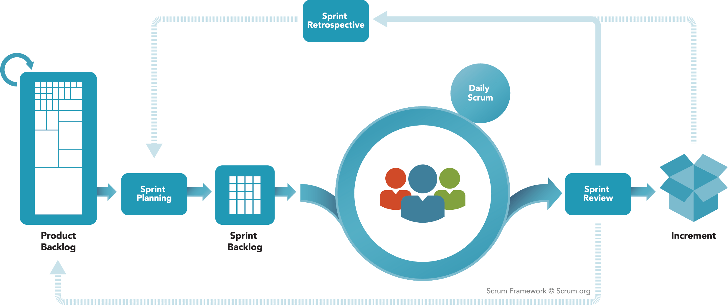
Scrum framework and Roles

Slide 9
Scrum Roles
The people on the Scrum Team
Scrum Master - the person on the Scrum Team who uses their knowledge of Scrum to help the team and organization to be as effective as they can be; they do so by taking approaches like coaching, teaching, facilitating and mentoring
Product Owner - the person on the Scrum Team who makes sure that the team is creating the most valuable product they can create
Developers - the people on the Scrum Team who work together to create the product

Slide 10
Agile Ceremonies
Sprint - short cycles of one month or less, during which the work is done; the Sprint contains all of the other Scrum events; a new Sprint starts immediately after the conclusion of the previous Sprint
Sprint Planning - event dedicated to planning out the work that will take place during the Sprint
Daily Scrum - event held every day where the Developers inspect the progress toward the Sprint Goal, uncover anything that may be getting in their way and adapt accordingly
Sprint Review - event held at the end of the Sprint where the Scrum Team and key stakeholders review what was accomplished in the Sprint and what has changed in their environment; next, attendees collaborate on what to do next
Sprint Retrospective - the Scrum Team gets together during this event to talk about how the last Sprint went and identify the most helpful changes to improve their effectiveness

Slide 11
SCRUM ARTIFACTS
Product Backlog - an evolving, ordered list of what is needed to improve the product; it is the single source of work undertaken by the Scrum Team
Commitment: Product Goal - the target the team plans against
Sprint Backlog - a highly visible list of work that is the Developer’s plan for the Sprint, which may evolve as they learn
Commitment: Sprint Goal - the single objective of the Sprint
Increments - small pieces of work that serve as concrete stepping stones toward the Product Goal. You can deliver as often as needed during the Sprint and are not limited to only one release per Sprint.
Commitment: Definition of Done - the description of what it takes for an Increment to be considered complete

Slide 12
Ceremonies & Artifacts
The agile ceremonies list includes:
Sprint Planning
Daily Stand-Up
Sprint Review
Sprint Retrospective

Slide 13
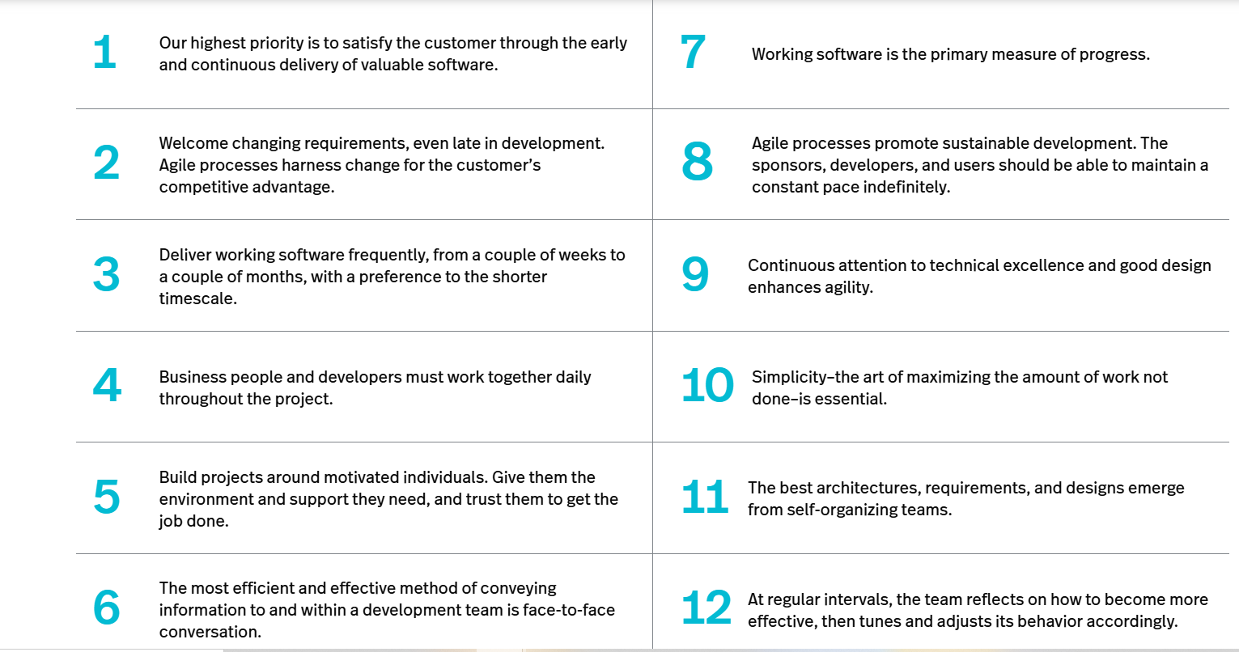
12 agile principles

Slide 14
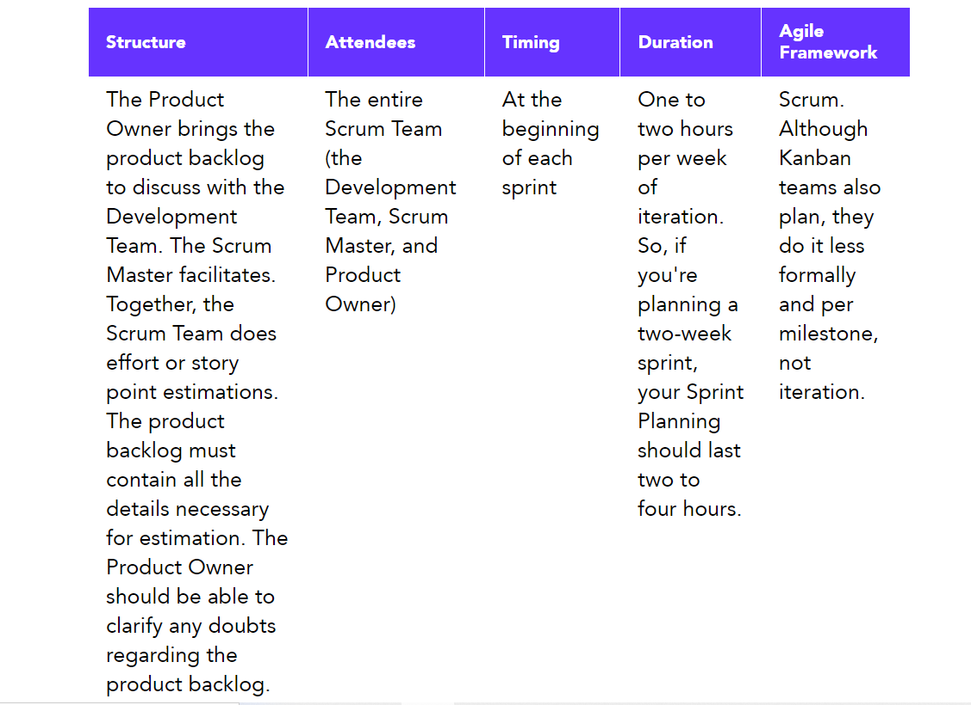

Slide 15
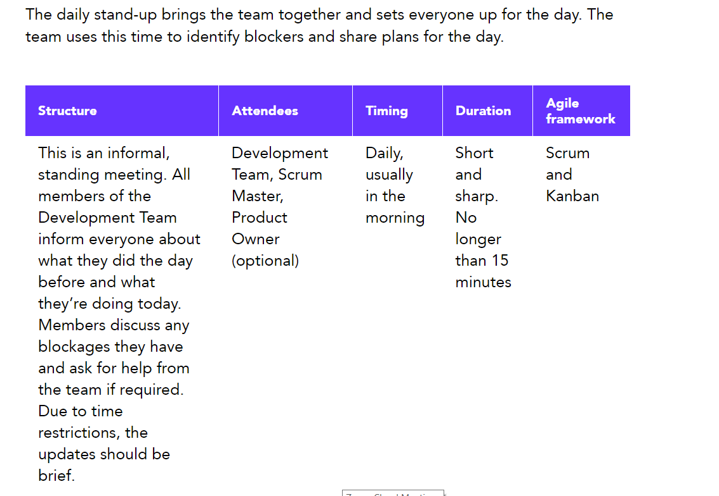

Slide 16
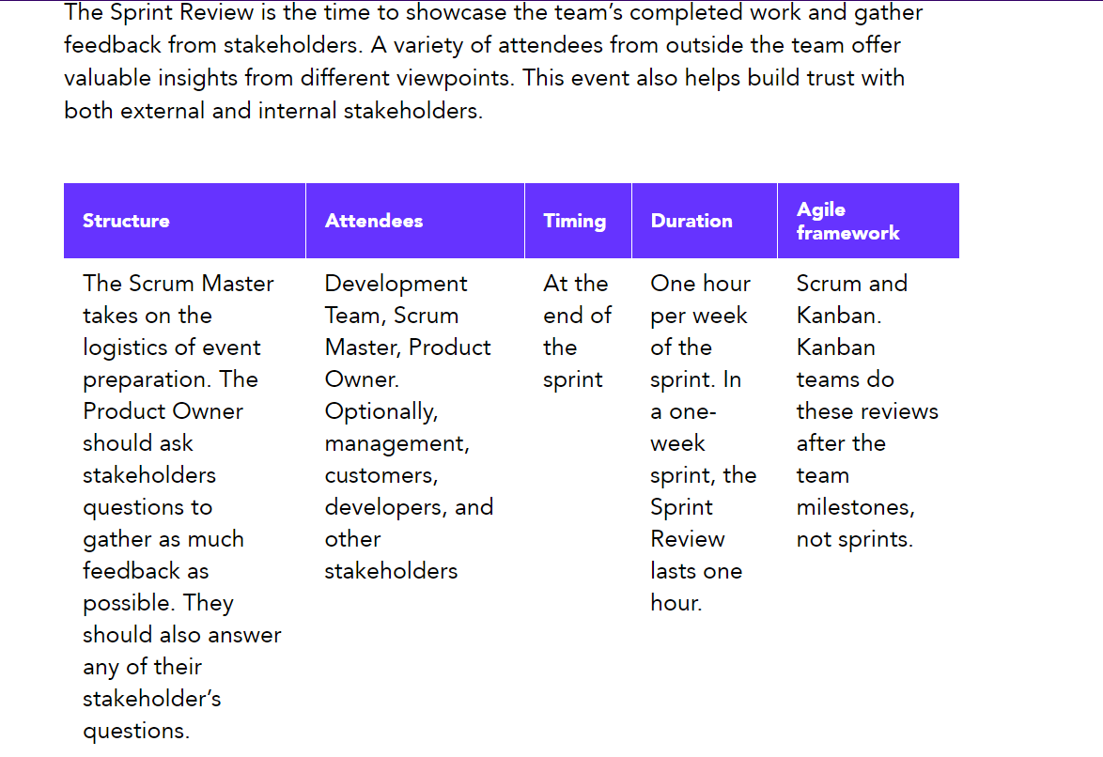

Slide 17
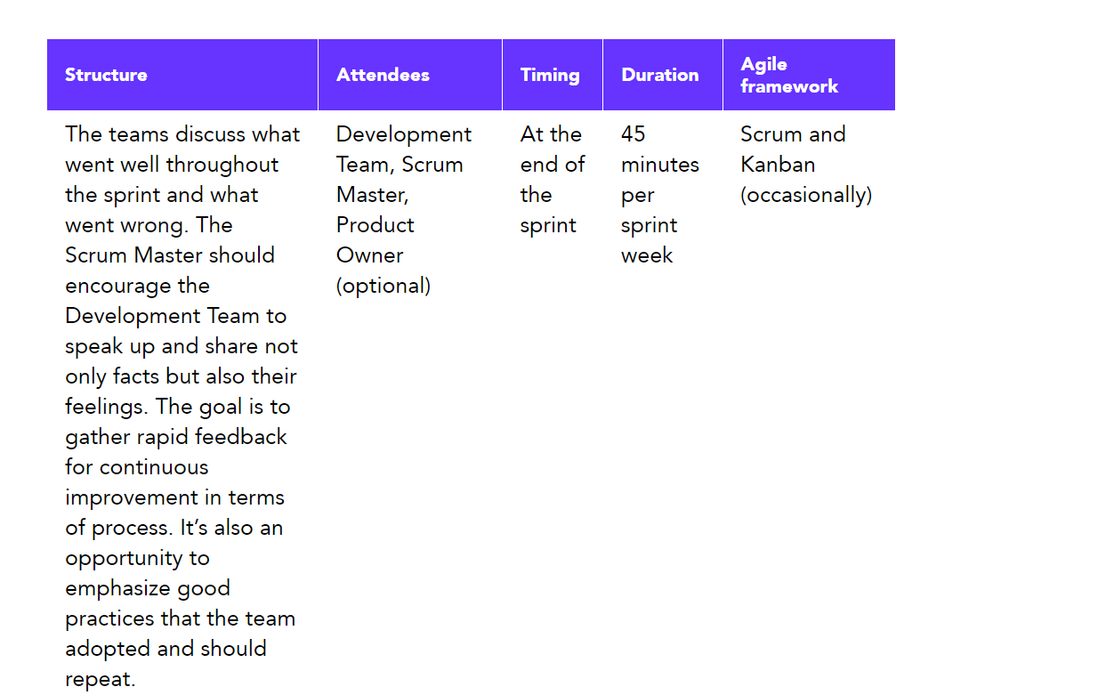

Slide 18
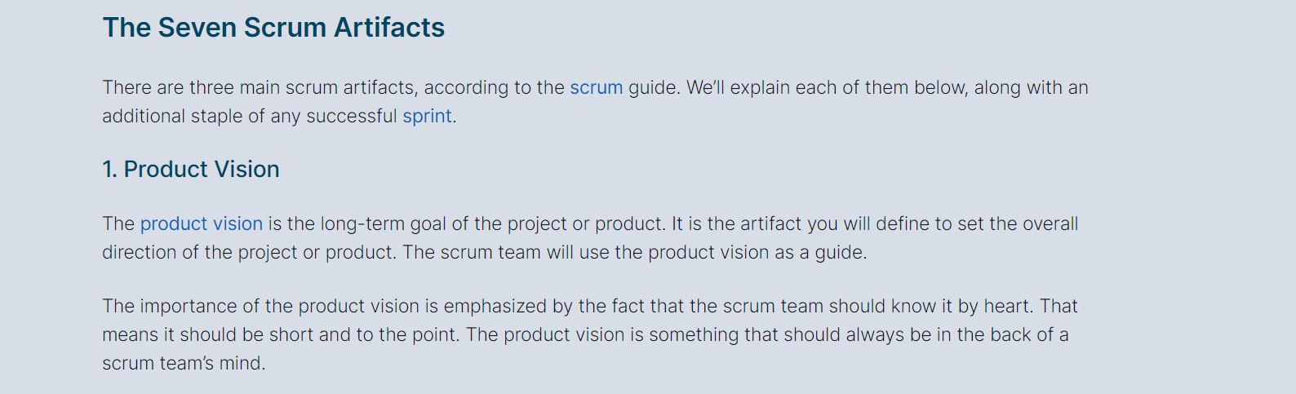

Slide 19
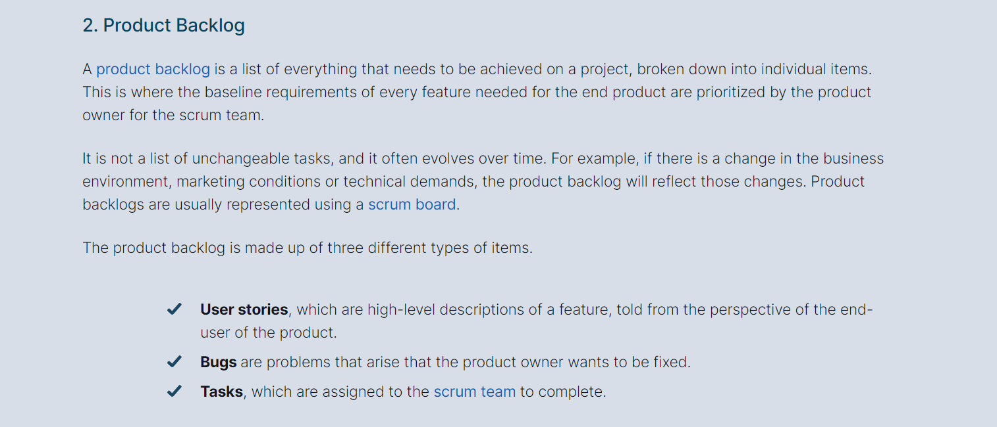

Slide 20
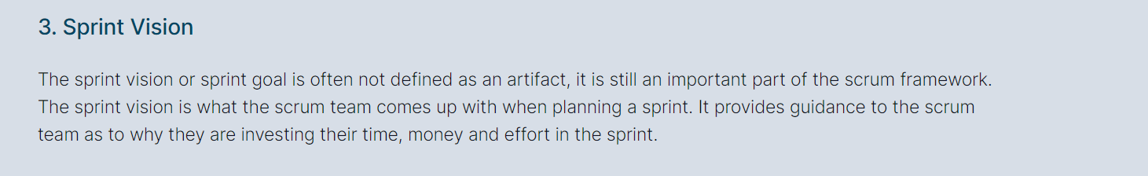

Slide 21
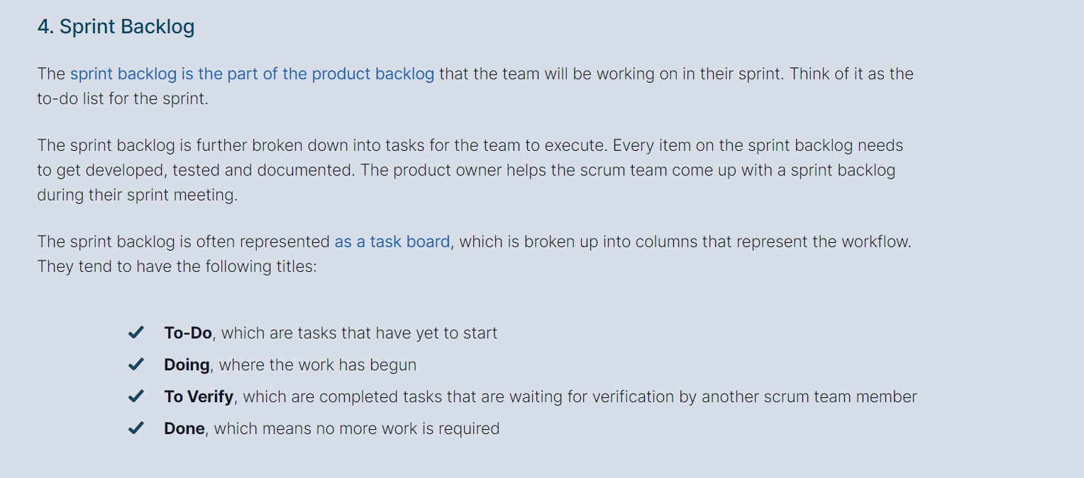

Slide 22
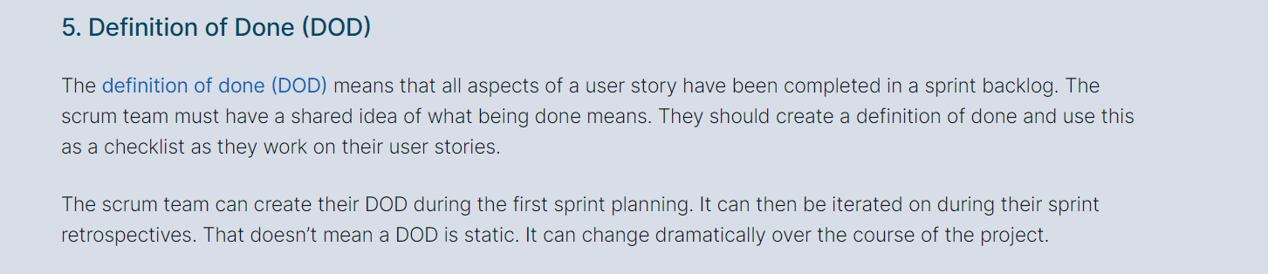

Slide 23
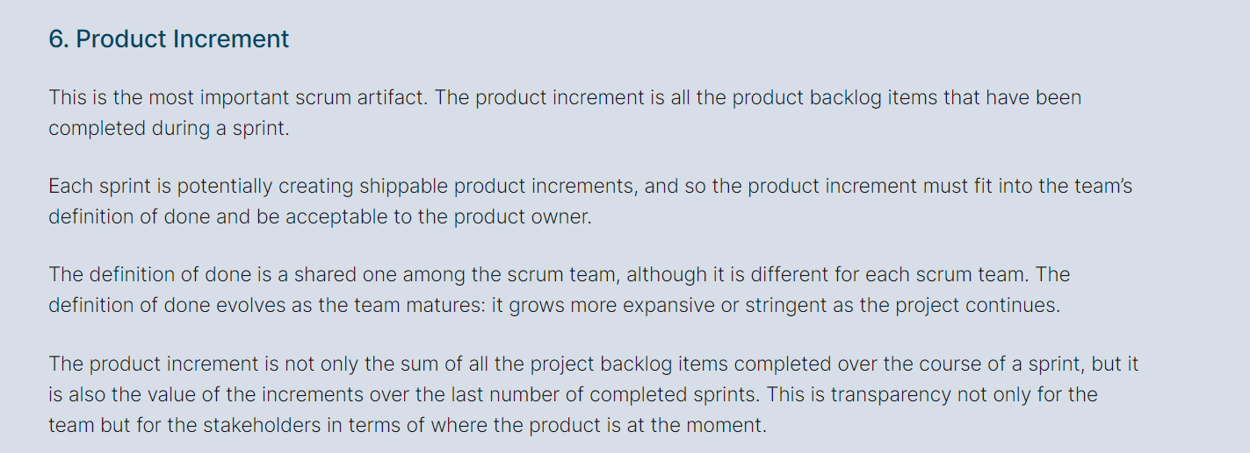

Slide 24
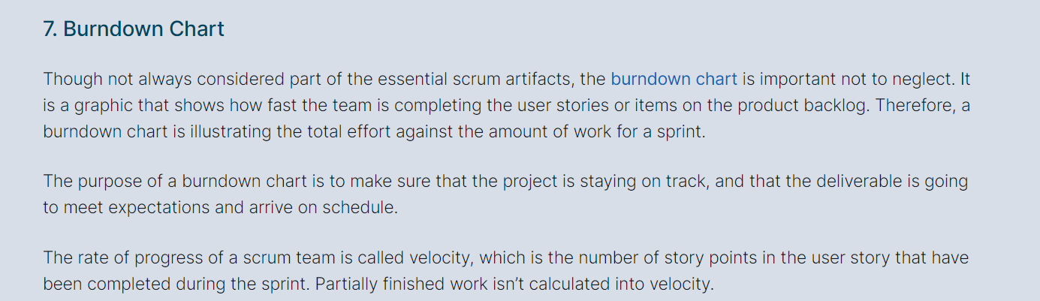

Slide 25
QA Vs QC vs QE

Slide 26
White box testing is done by the developer or ?
Unit is done by developer.
Signup
-username pwd
-gmail
-facebook
-forget password
White box testing when developer is developing the code, is done by the developer

Slide 27
tester integration testing and system testing
white box testing technique
……………………………………………………..

Slide 28
verification vs validation?who

Slide 29
smoke and sanity?Who

